Slide 1
Session 2020-21 CSTE-3101 Communication Engineering

Slide 2
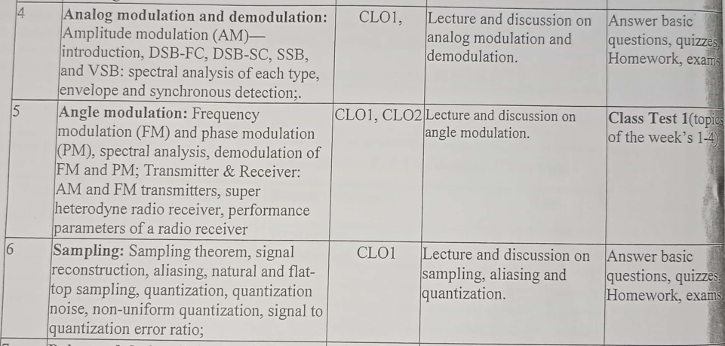
Week: 4-8

Slide 3
Book Reference
Modern digital and analog communication: B. P Lathi
Communication systems by Simon S. Haykin
Communication systems: Analog and Digital by Sanjay Sharma
Data Communications and Networking by Behrouz A. Forouzan, McGraw-Hill.

Slide 4
Overview of Communication System

Slide 5
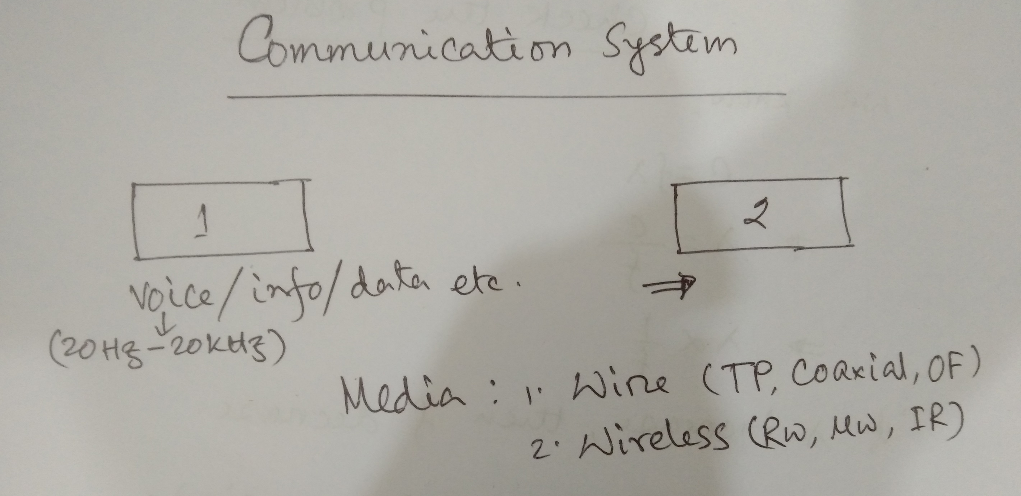

Slide 6
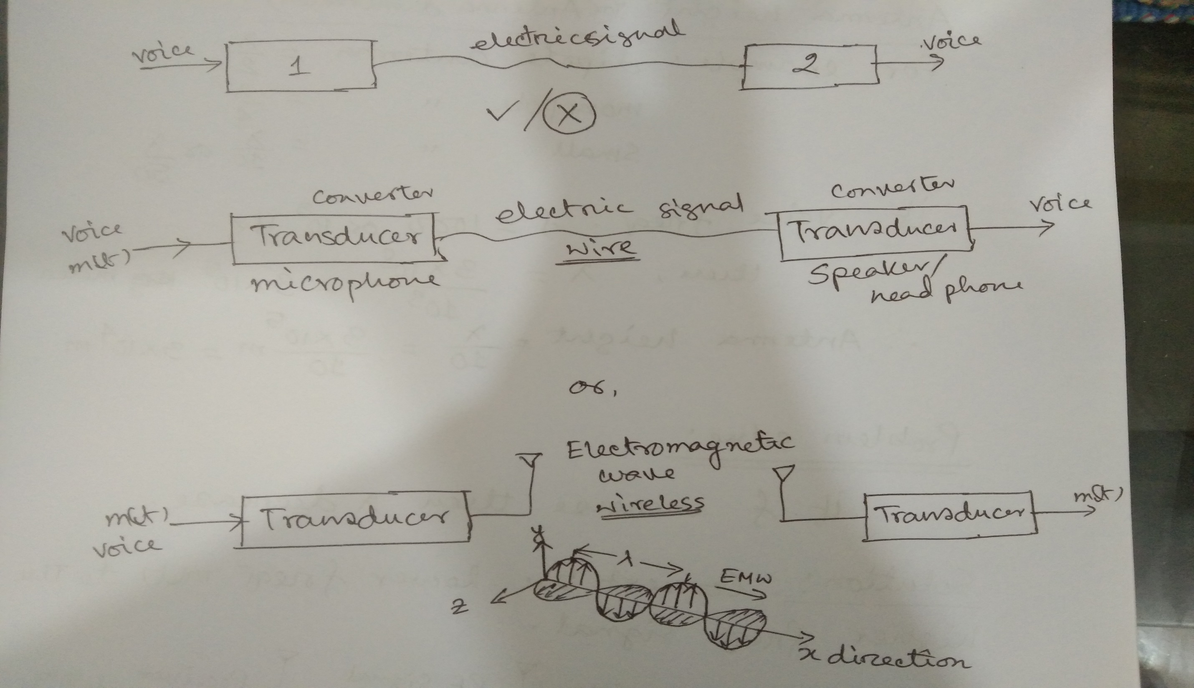

Slide 7
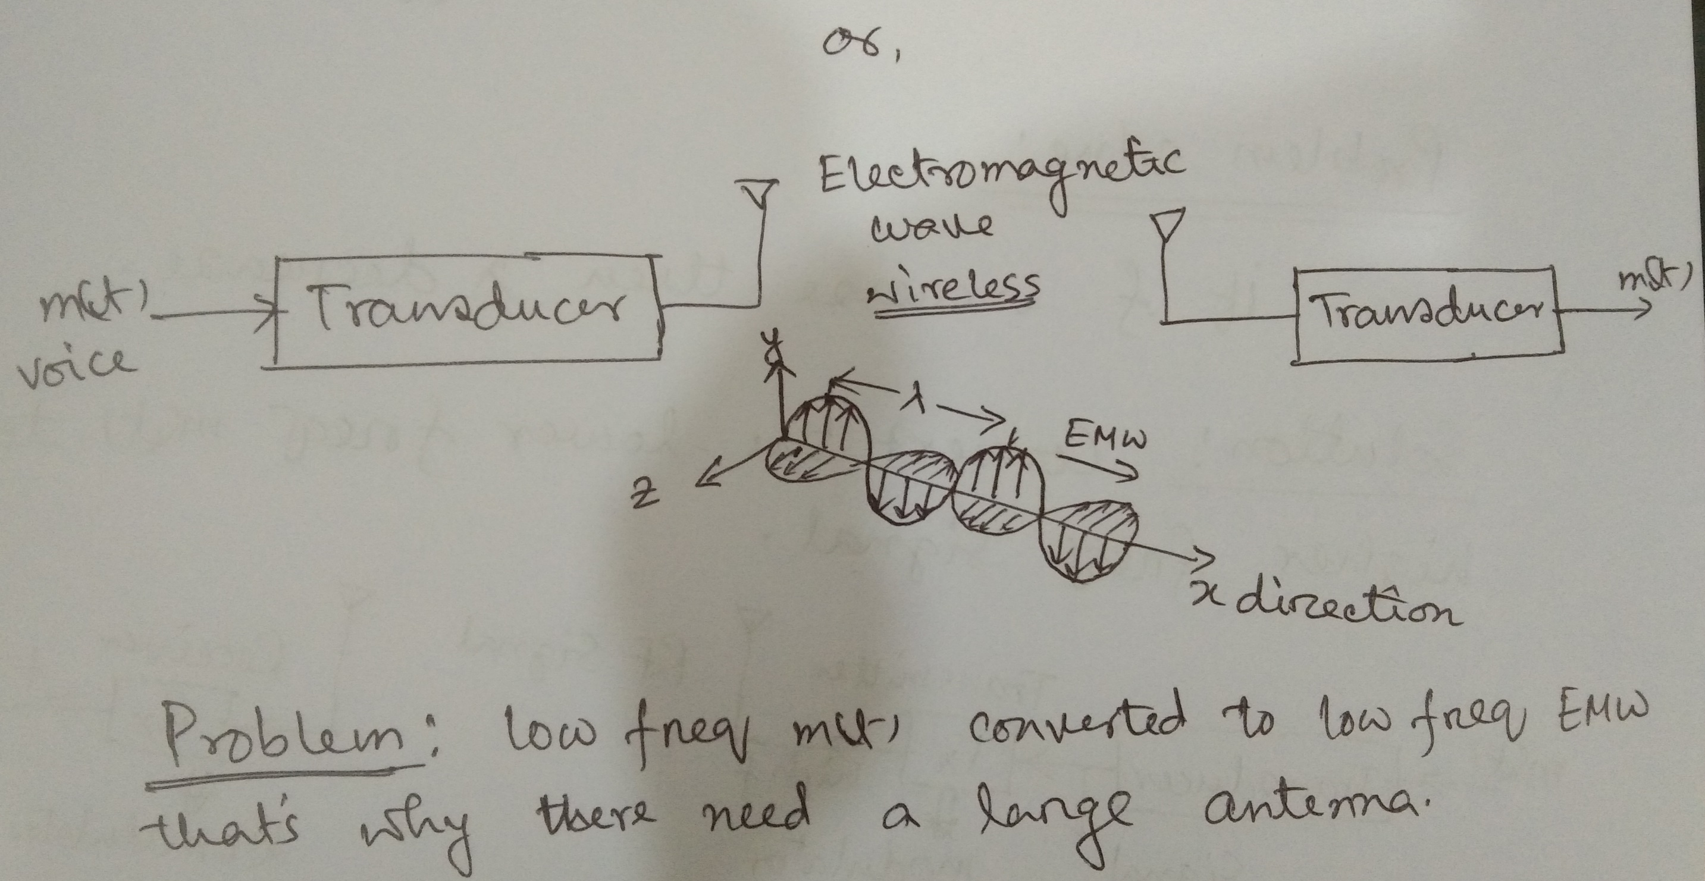

Slide 8
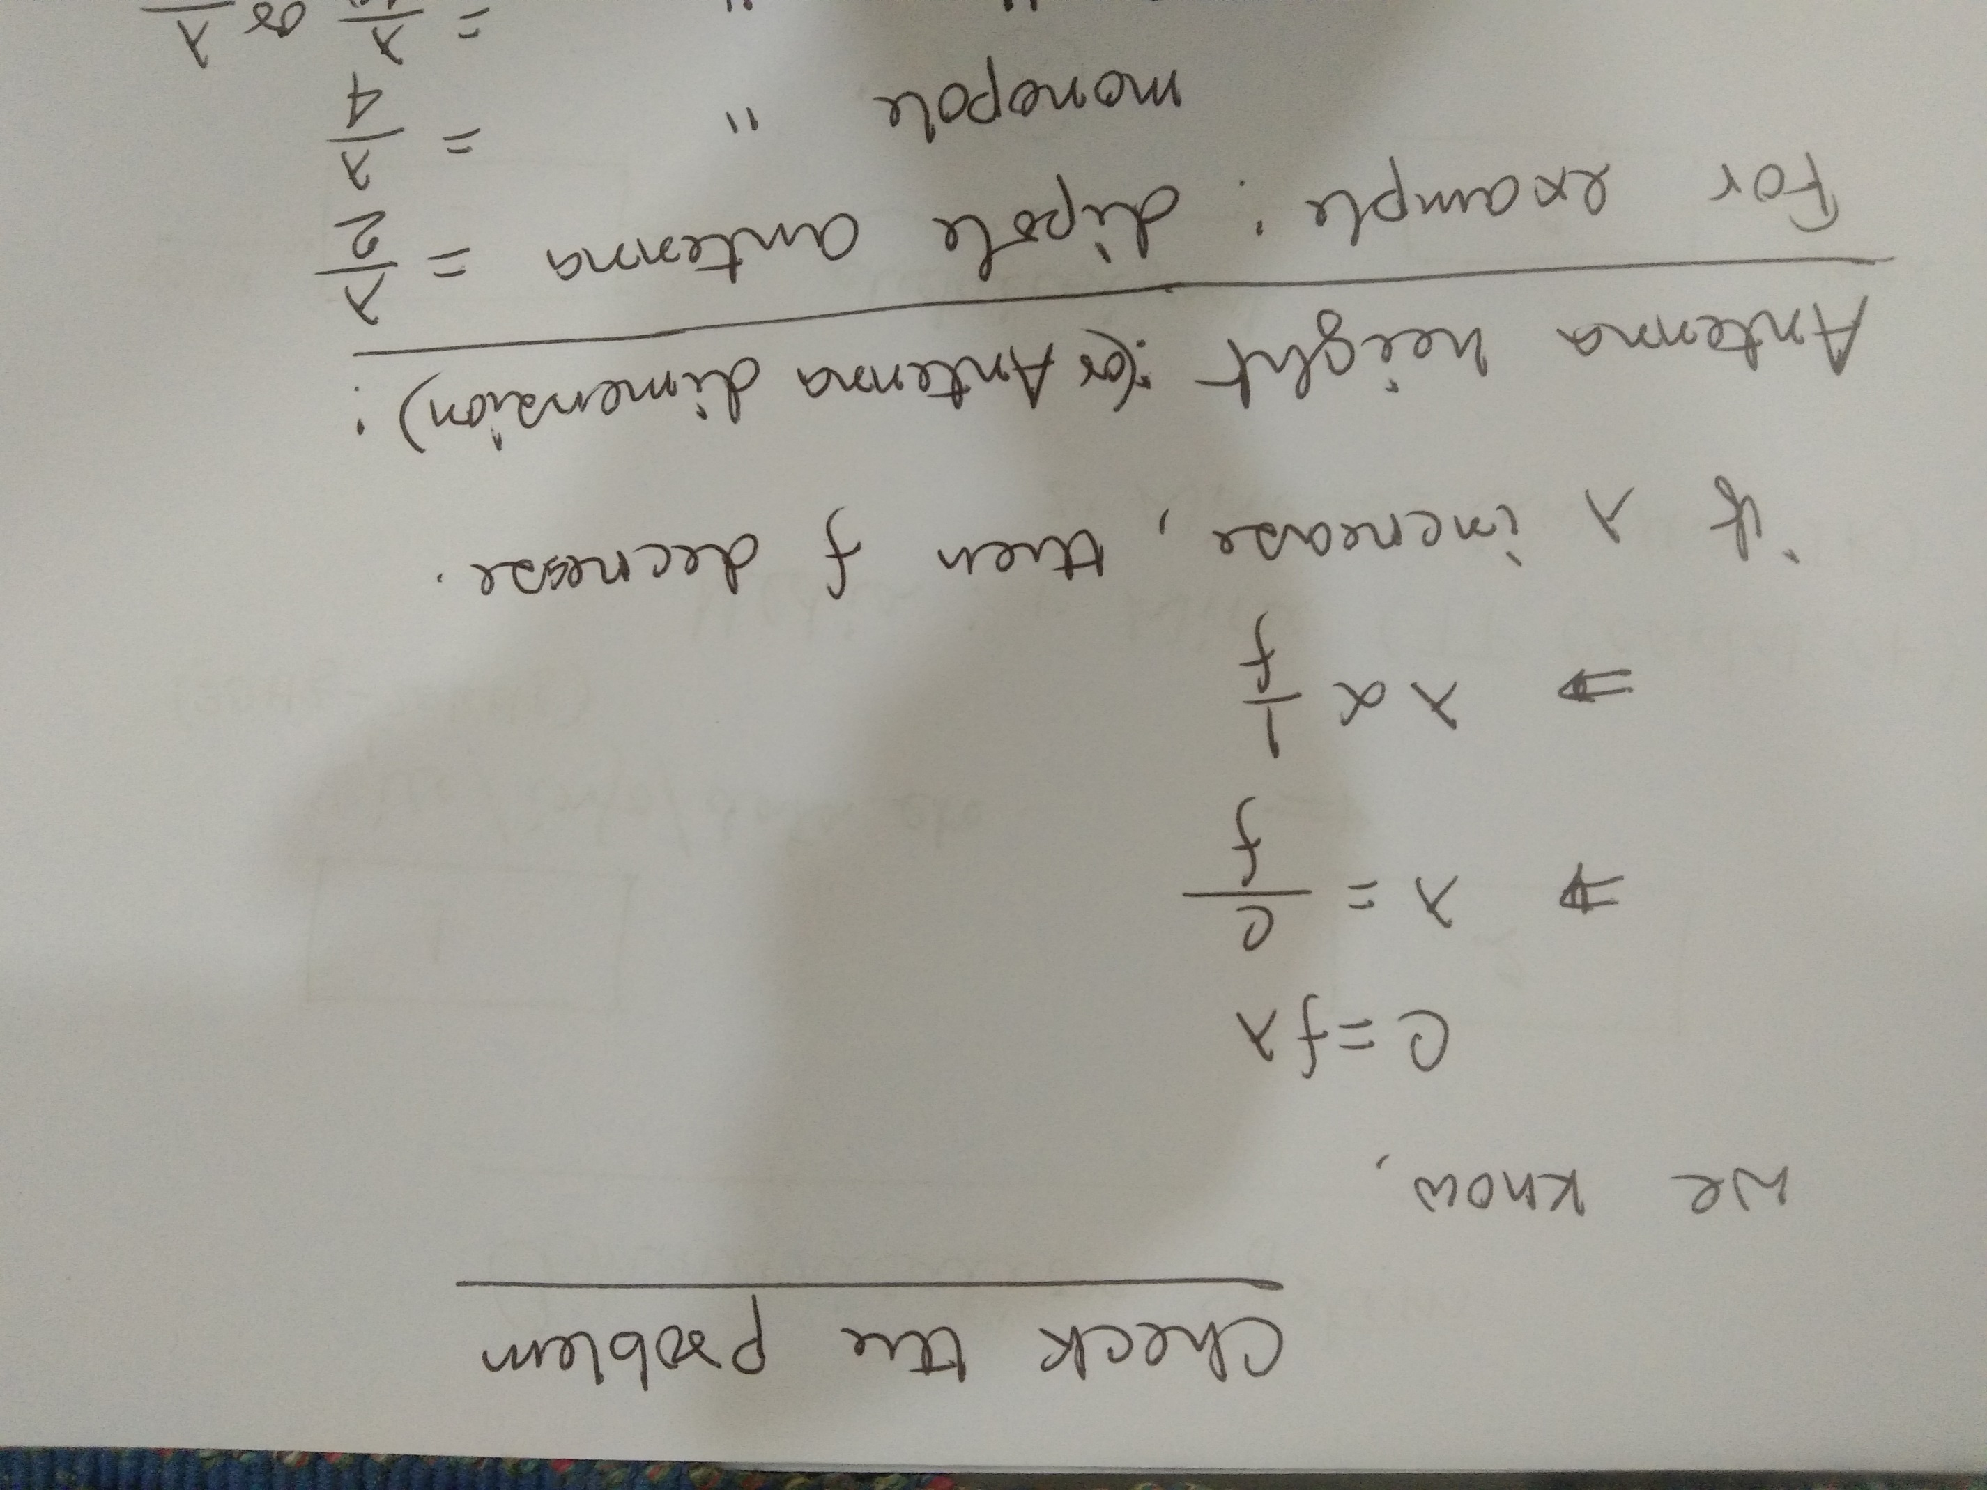

Slide 9
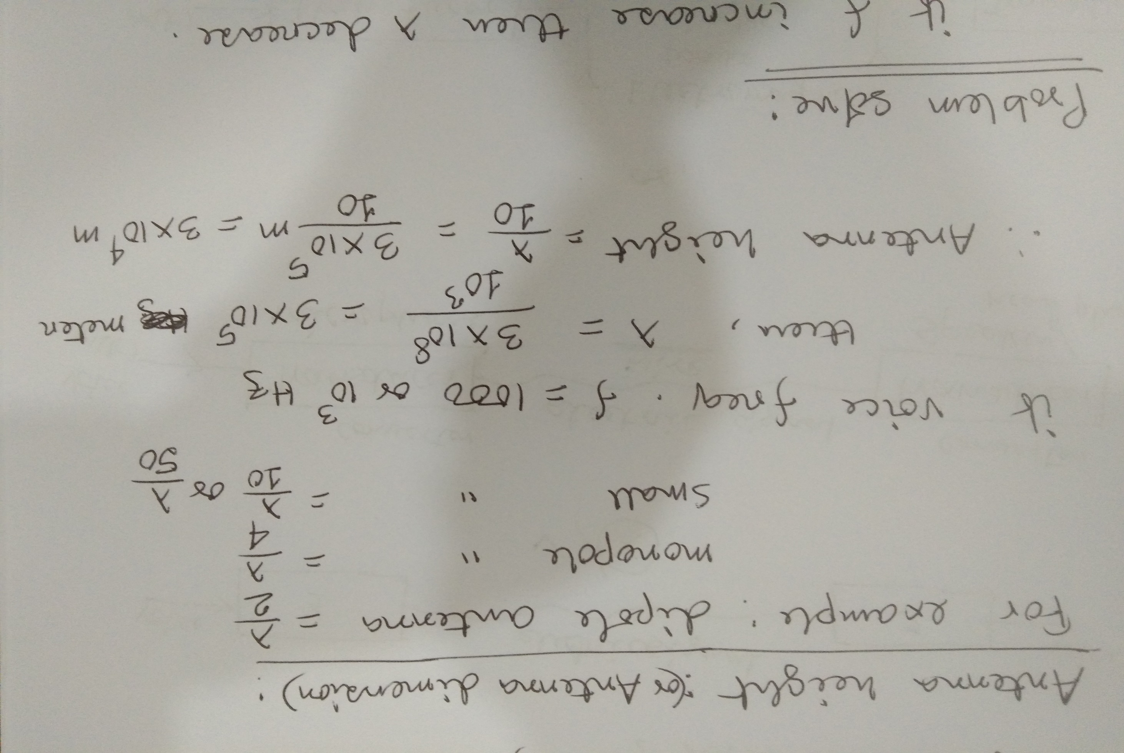
Hertzian antenna

Slide 10
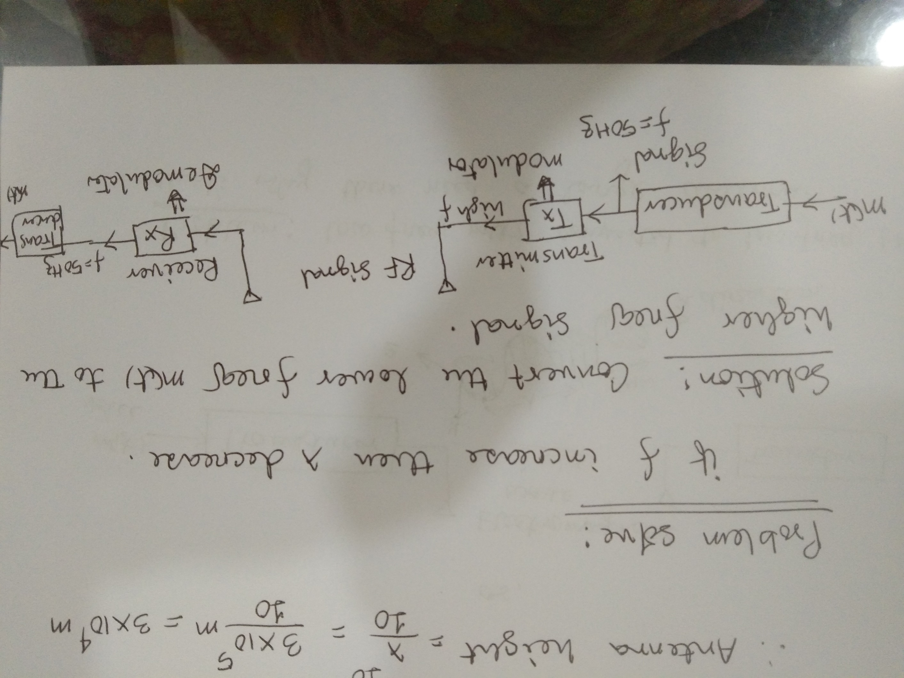

Slide 11
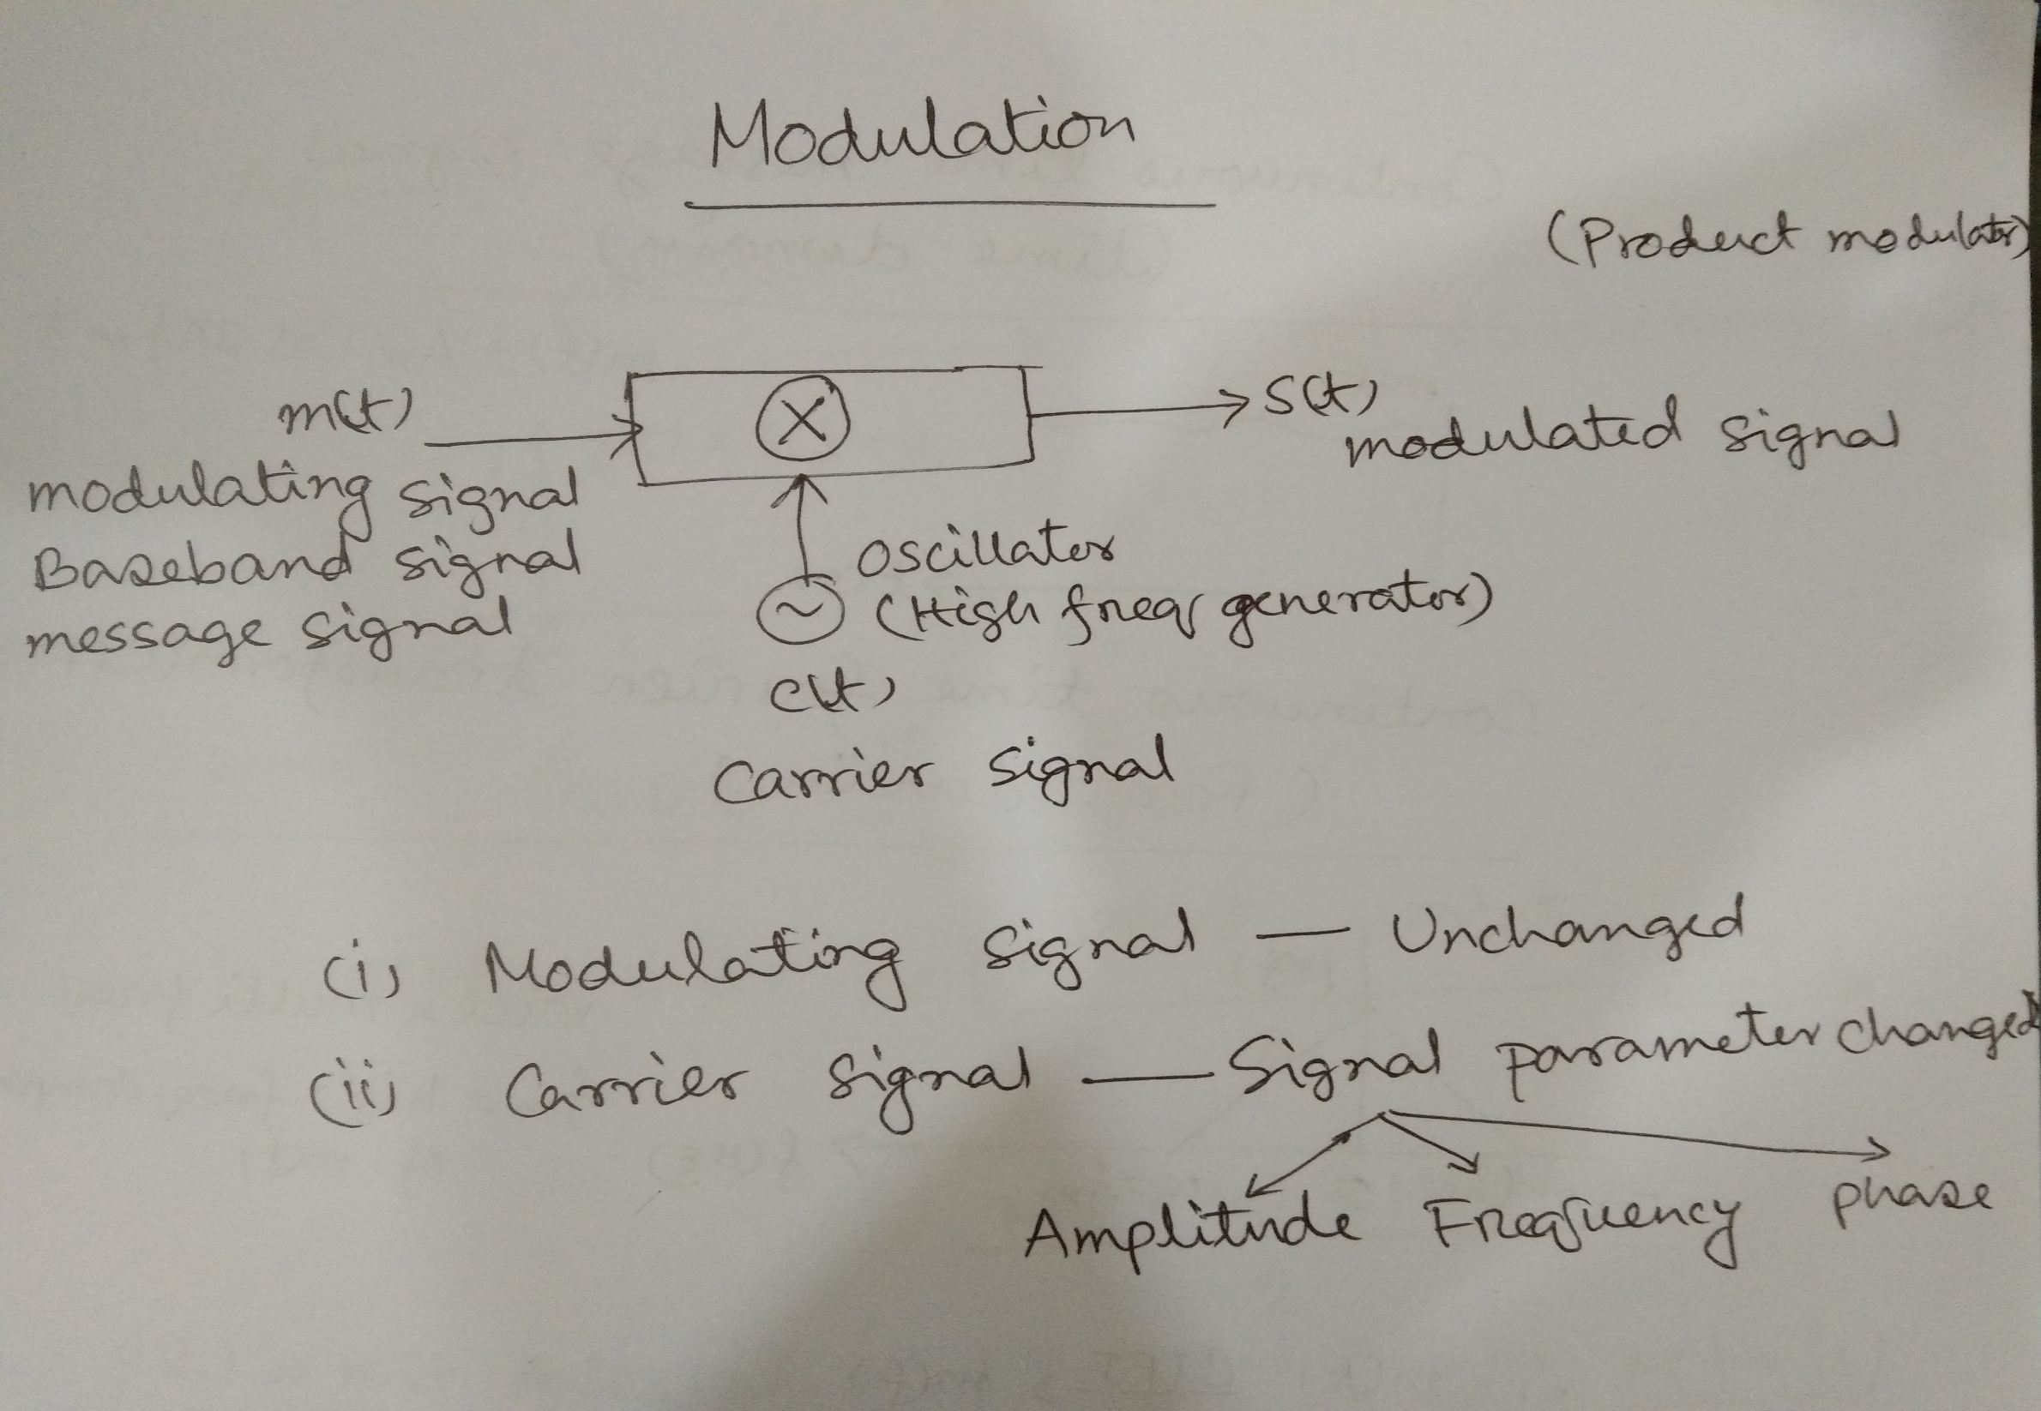

Slide 12
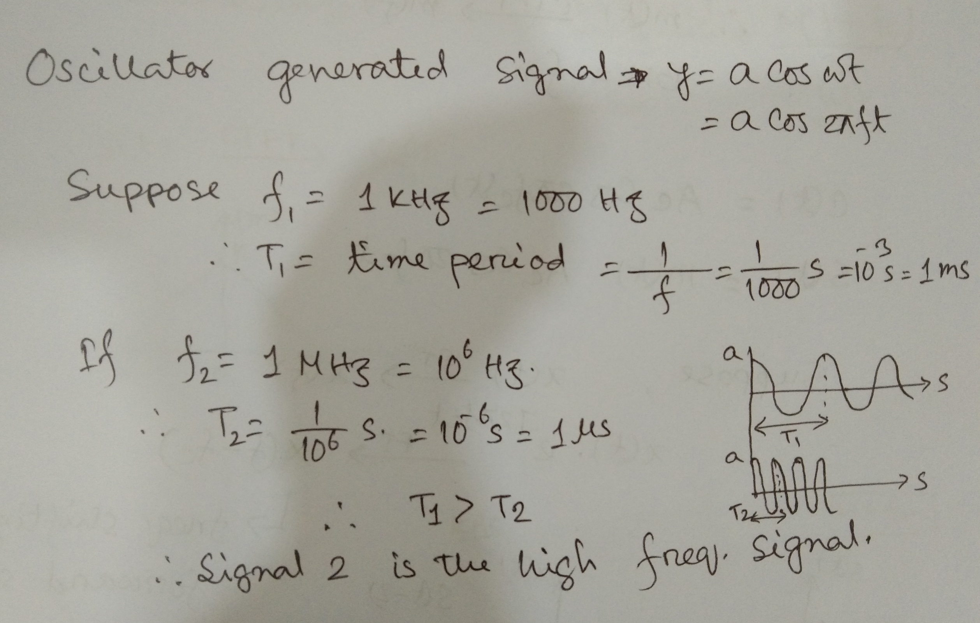

Slide 13
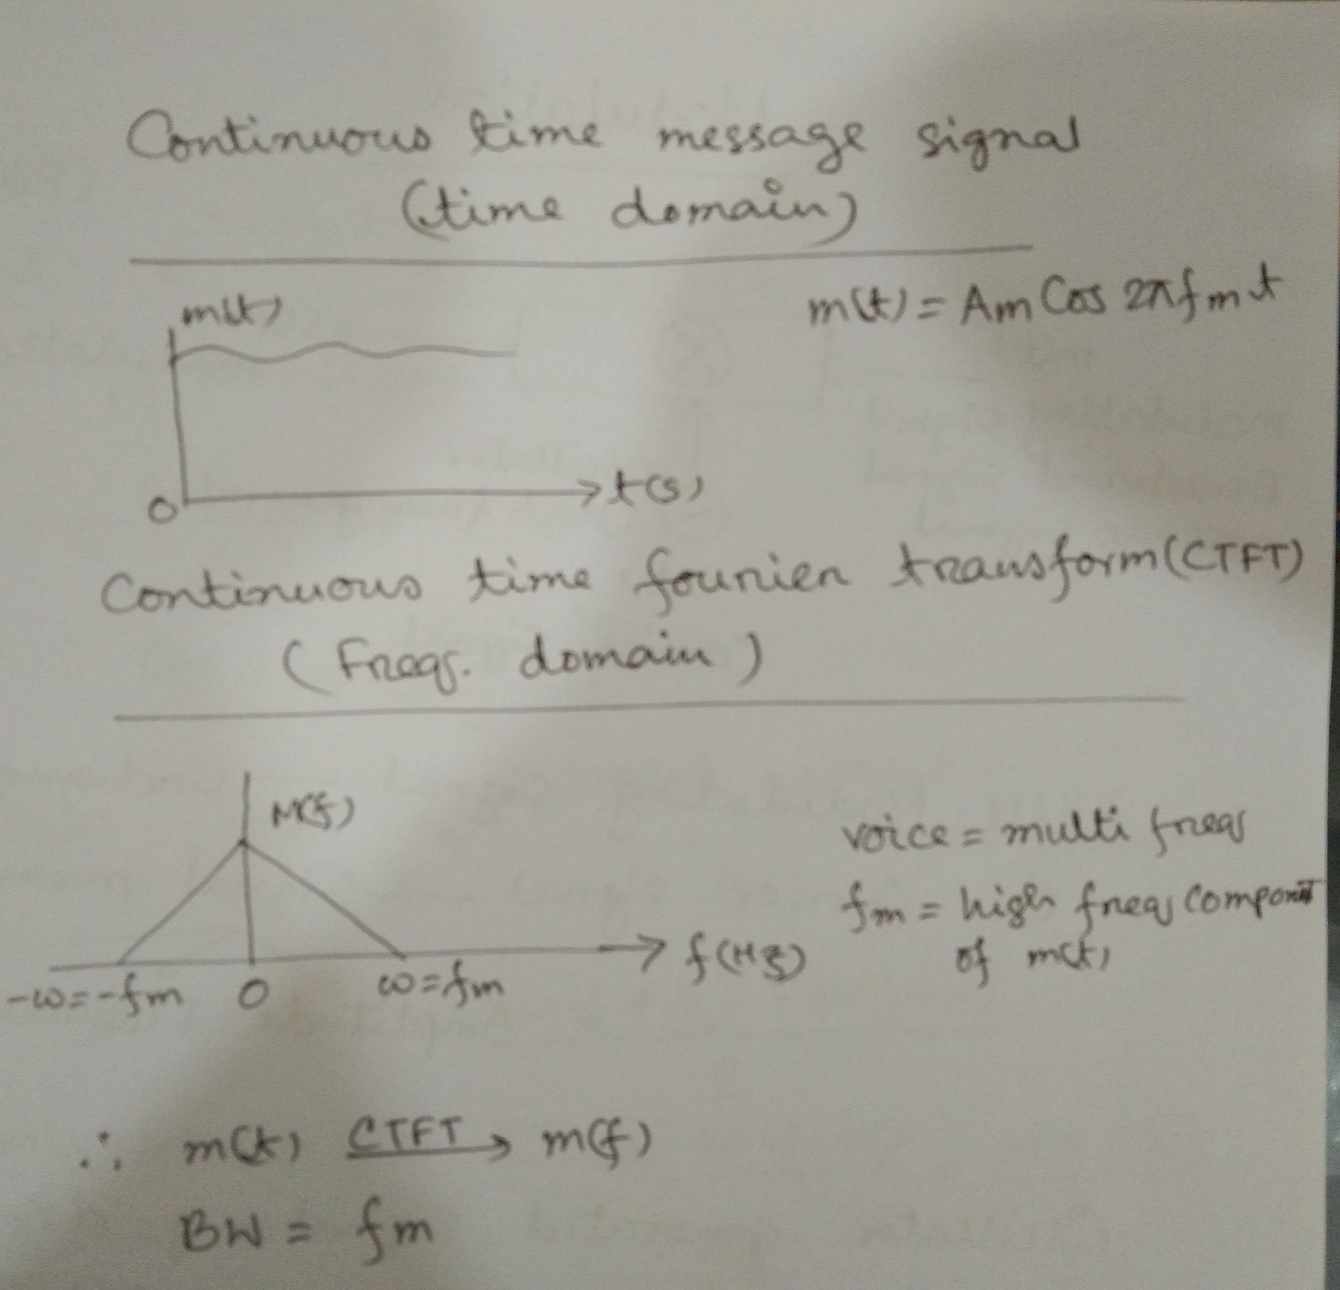

Slide 14
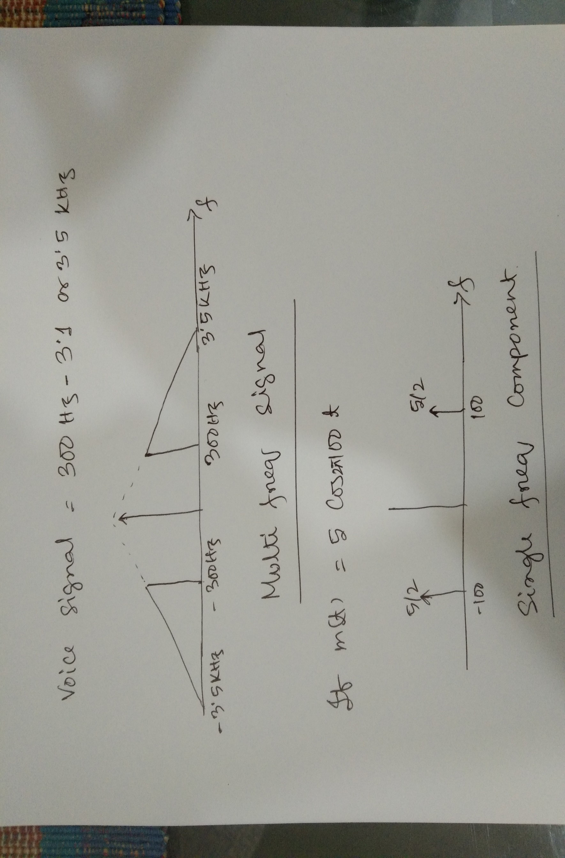

Slide 15
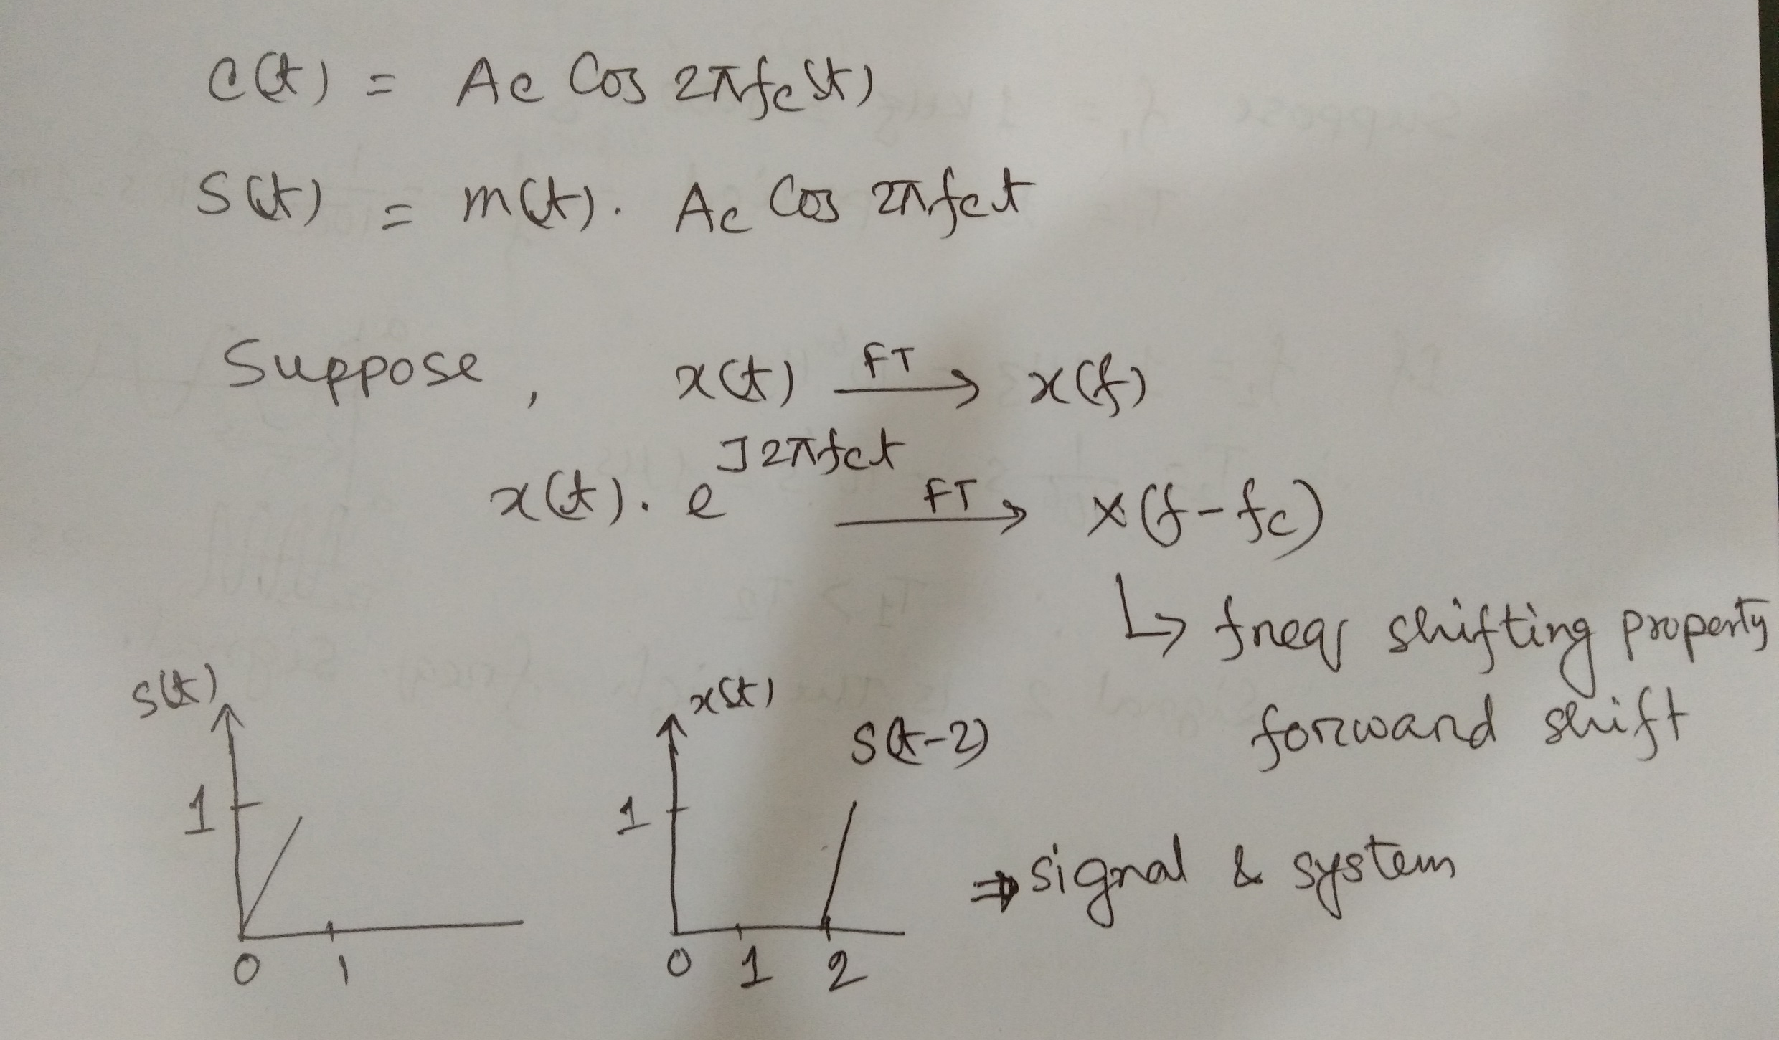
m(t)=Am cos 2pifmt

Slide 16
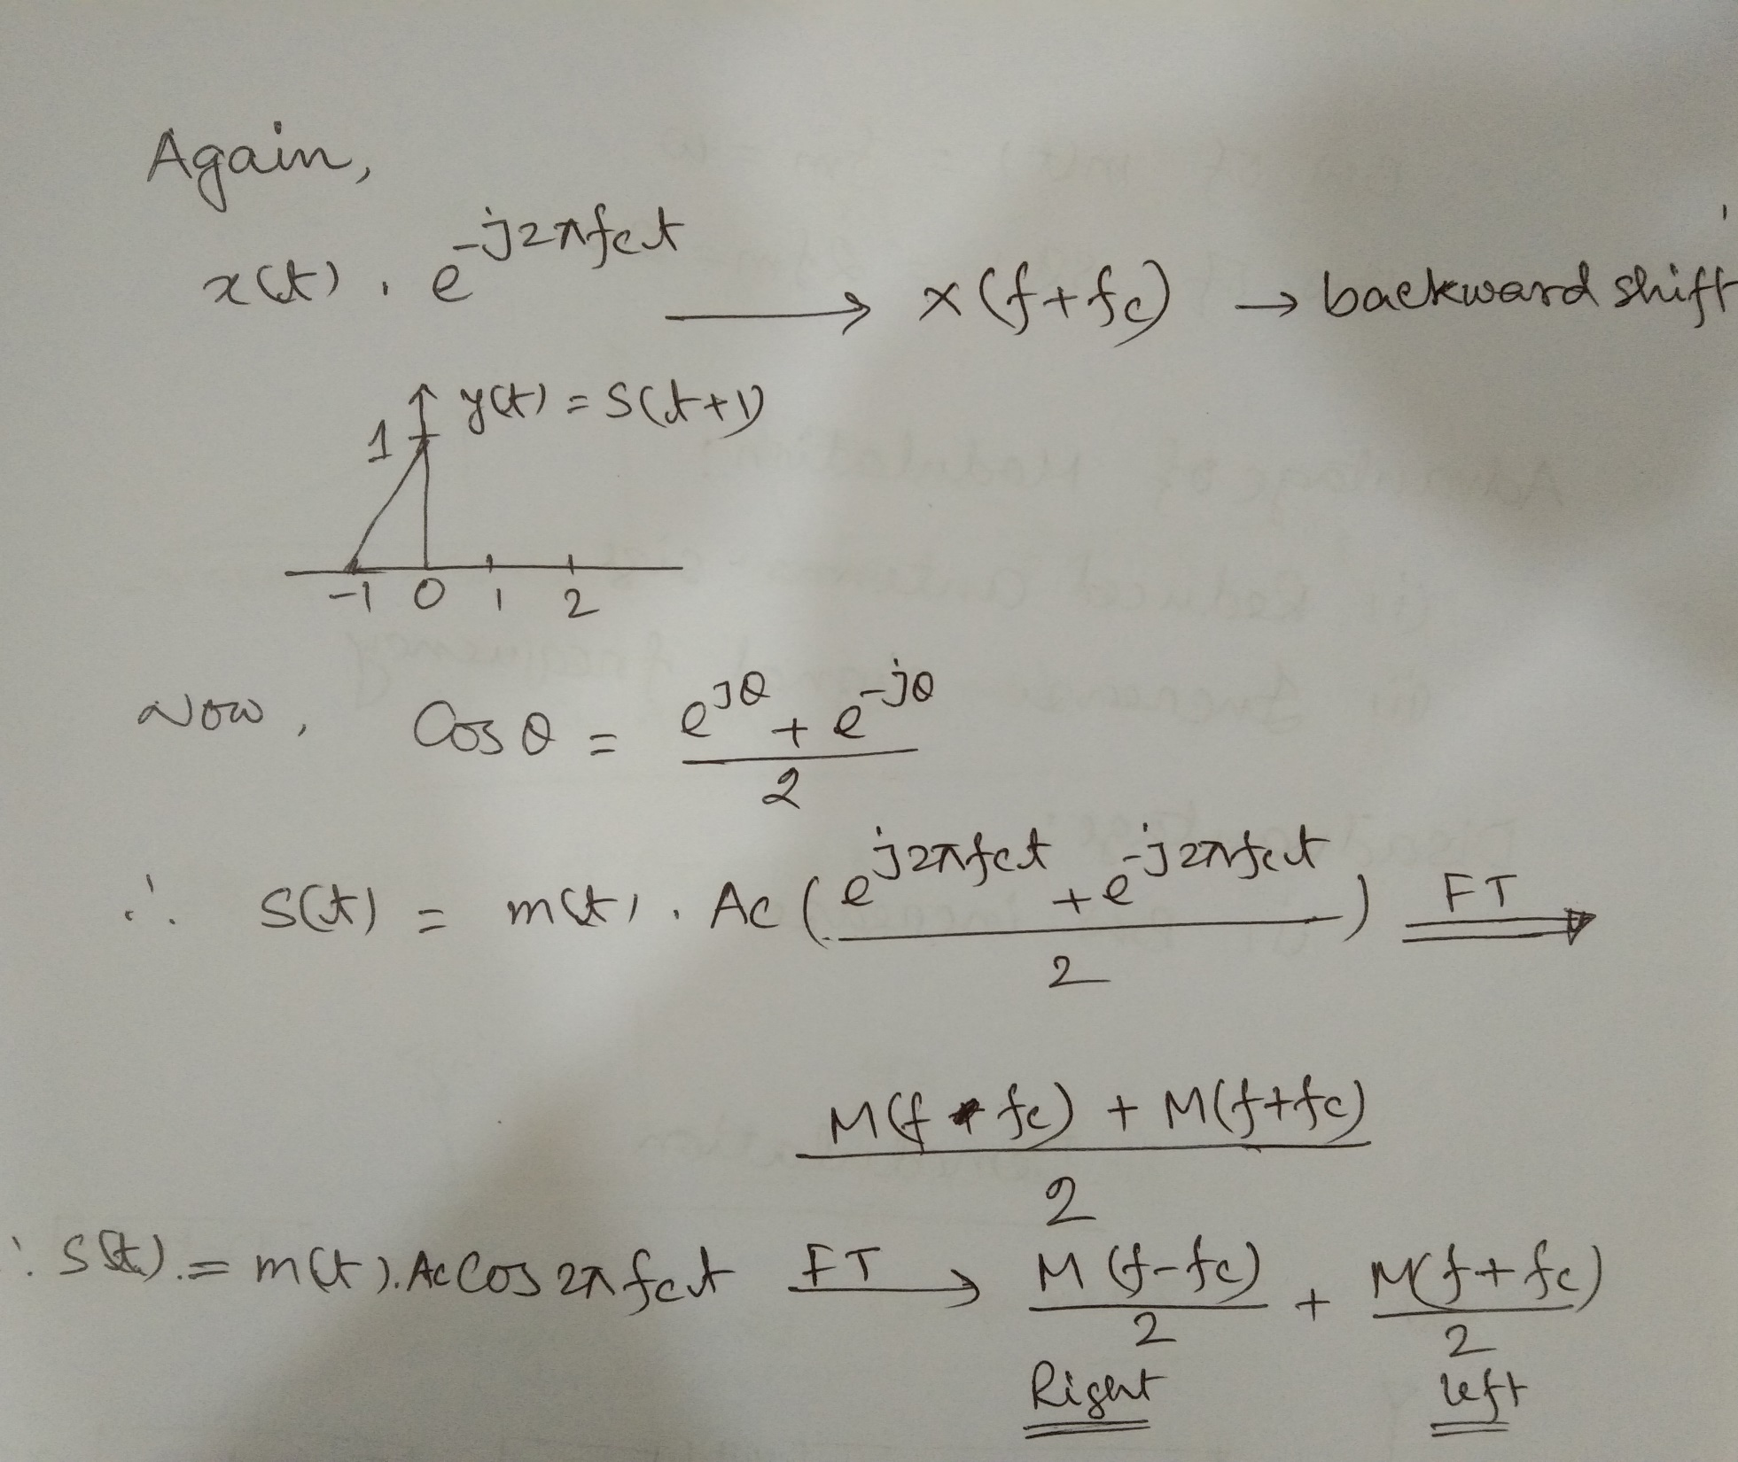

Slide 17
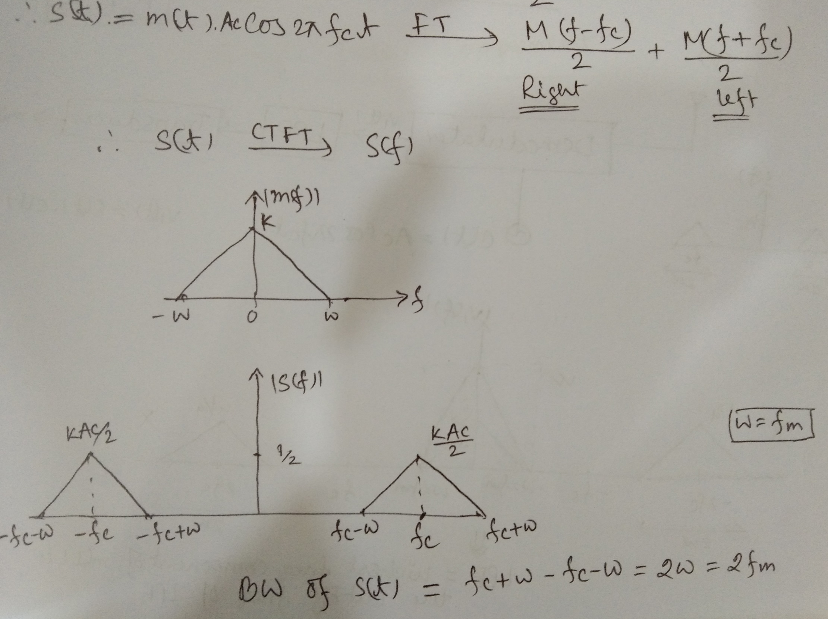

Slide 18
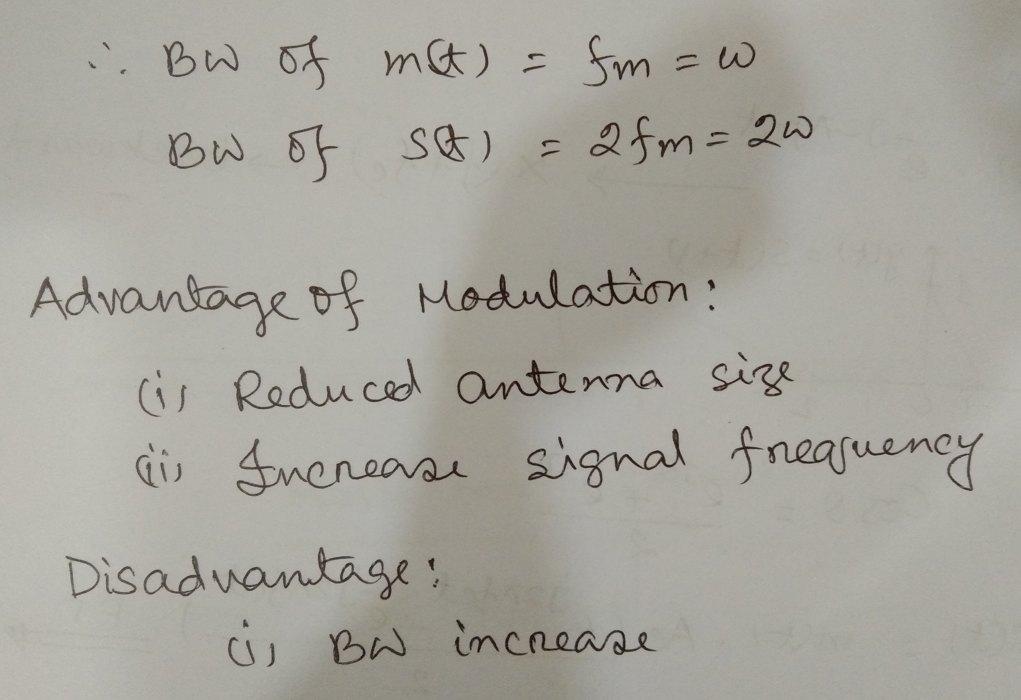

Slide 19
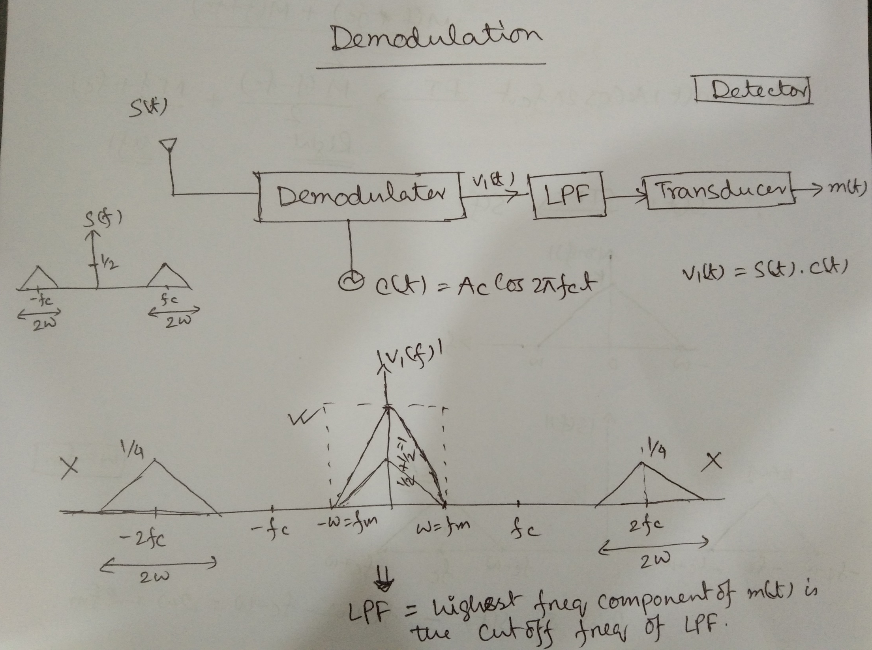
Synchronous detector/ coherent detector

Slide 21
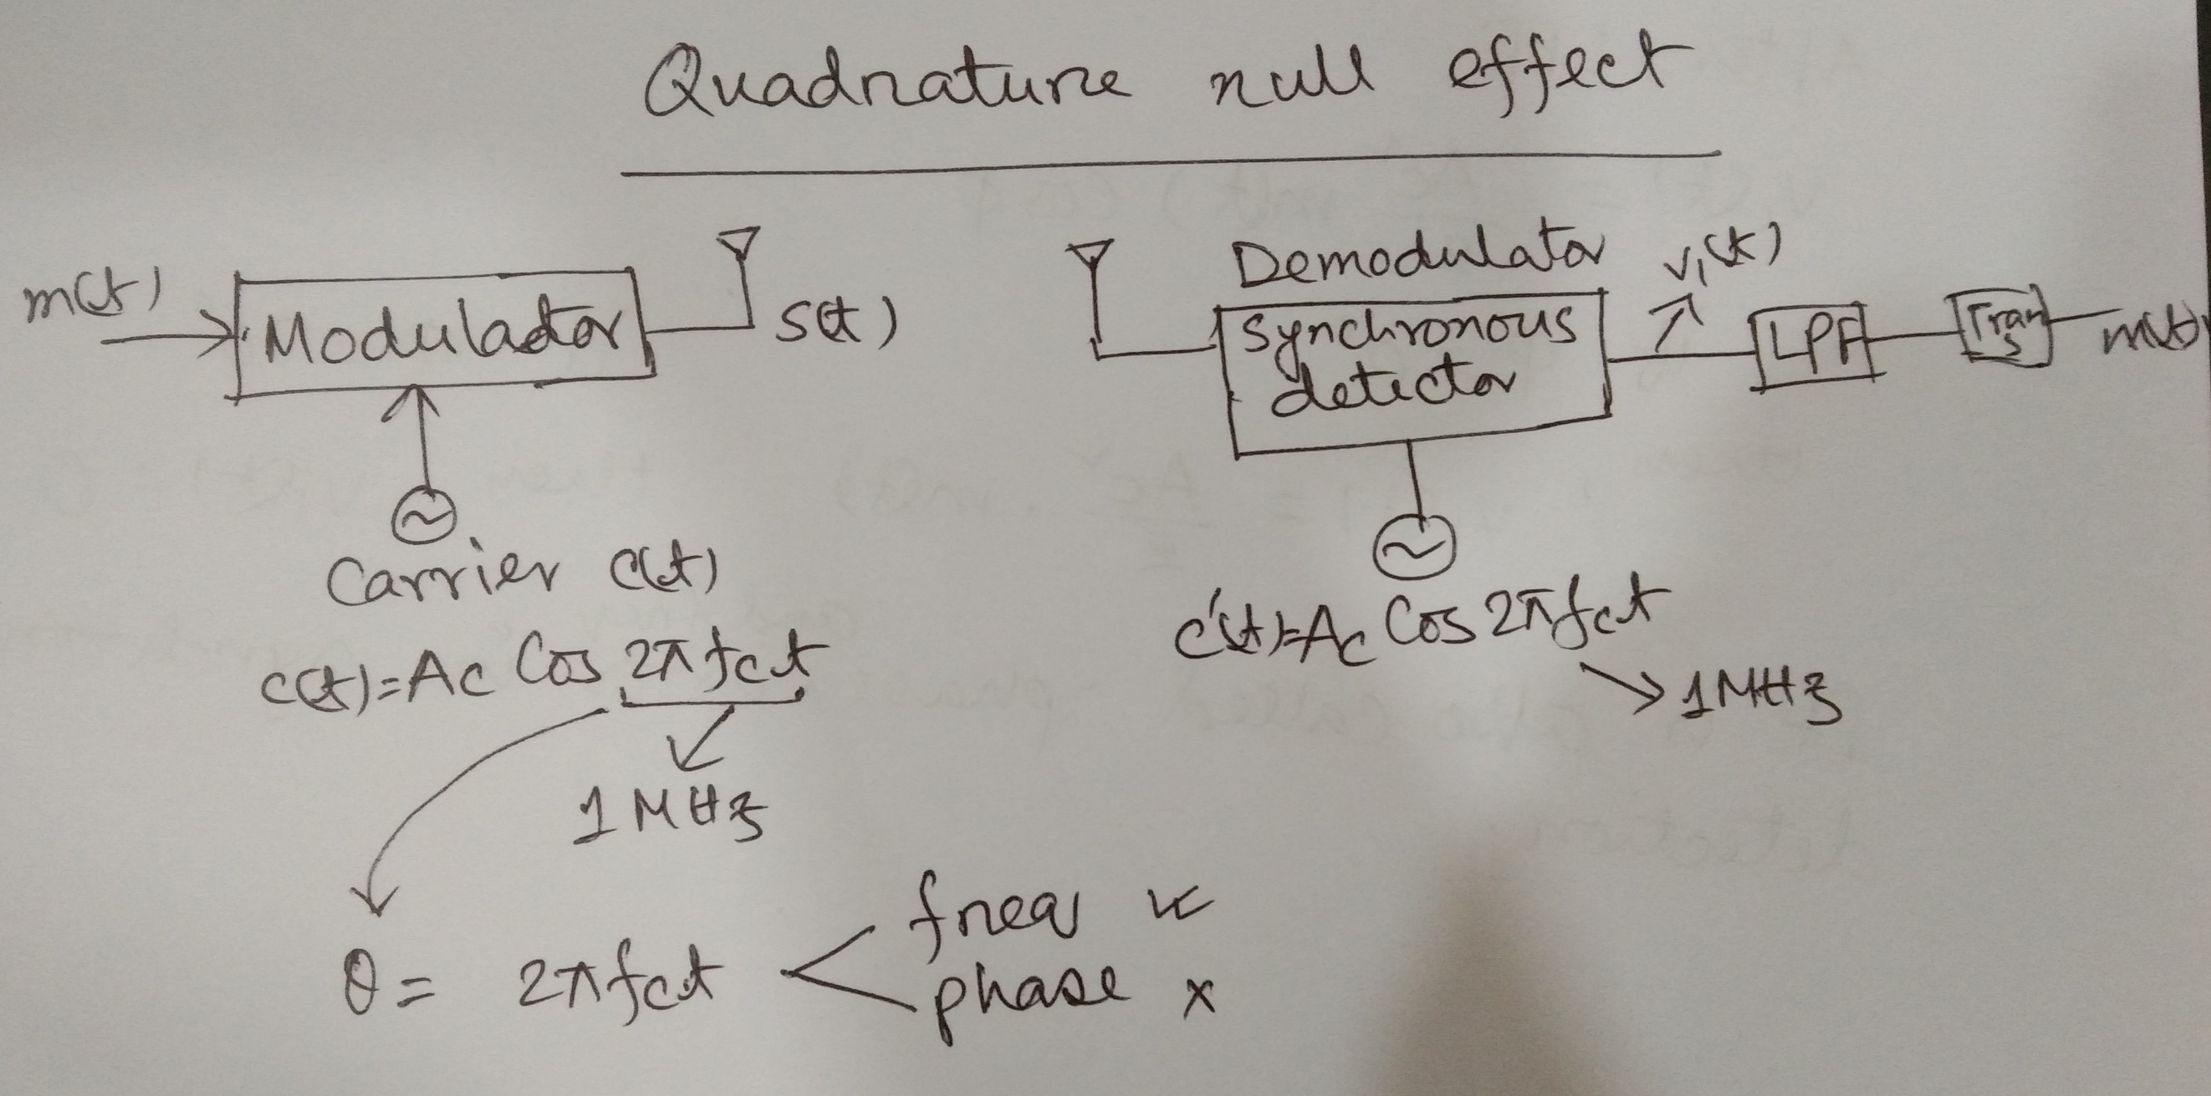

Slide 22
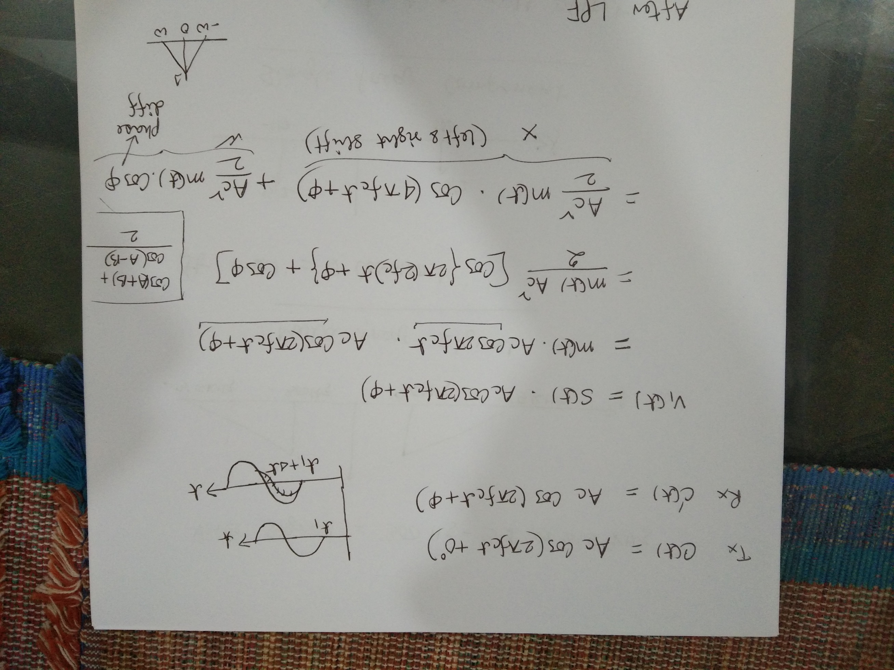

Slide 23
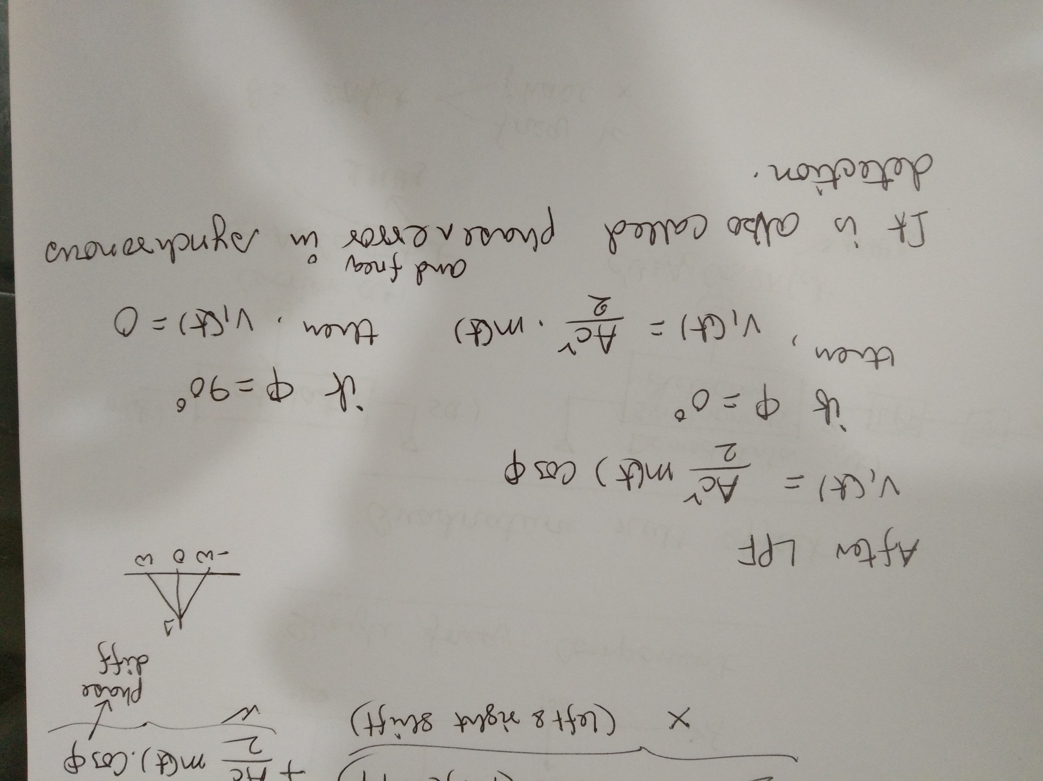

Slide 25
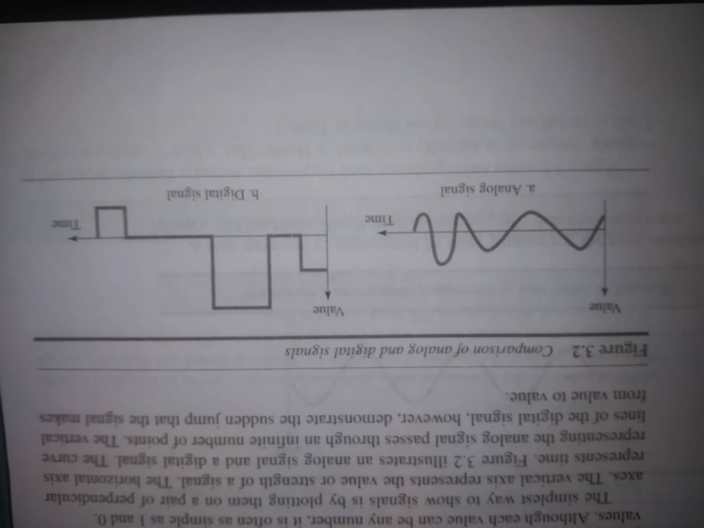
Analog and Digital Signal

Slide 26
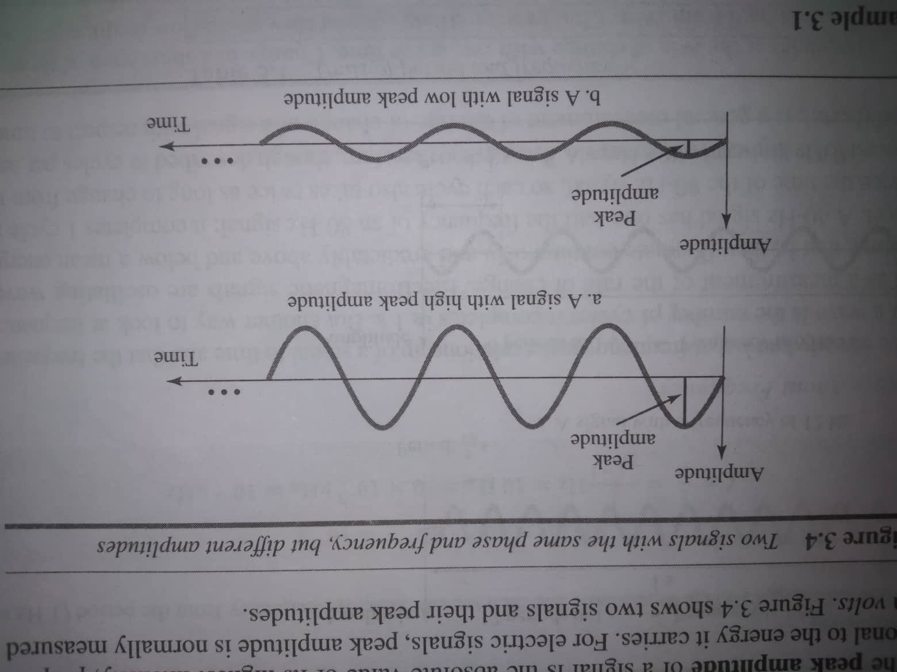
Periodic Analog Signal
Example:
Sine Wave
Period: T=1/f ; unit= second
Frequency: f=1/T; unit=hertz

Slide 27
Periodic Analog Signal
Phase/ Phase shift: It describes the position of the waveform relative to time 0

Slide 28
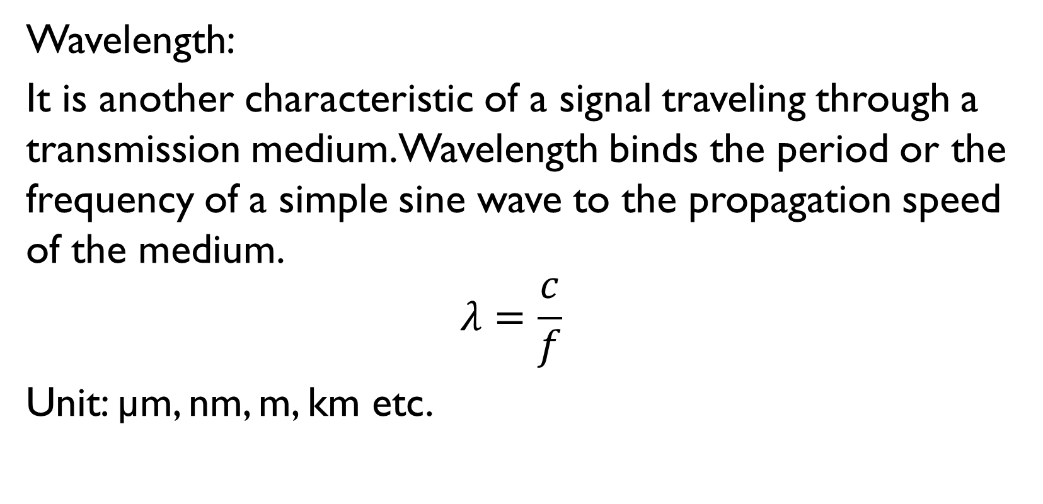
Periodic Analog Signal
Wavelength:
It is another characteristic of a signal traveling through a transmission medium. Wavelength binds the period or the frequency of a simple sine wave to the propagation speed of the medium.
$$λ=\frac{c}{f}$$
Unit: µm, nm, m, km etc.

Slide 29
Time and Frequency Domain
A sine wave is defined by its amplitude, frequency and phase.
To show a sine wave by using what is called a time-domain plot (amplitude (y-axis) vs time (x-axis) plot).
To show the relationship between amplitude and frequency by using what is called a frequency-domain plot. A frequency-domain plot is concerned with only the peak value and the frequency. Changes of amplitude during one period are not shown.

Slide 30
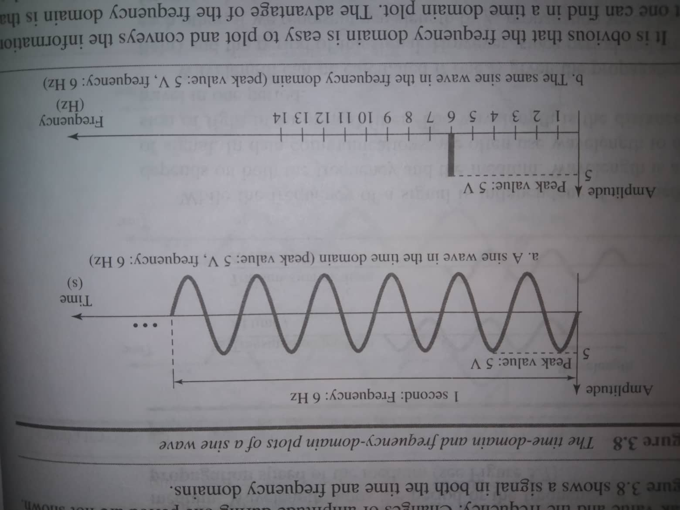
Time and Frequency Domain

Slide 31
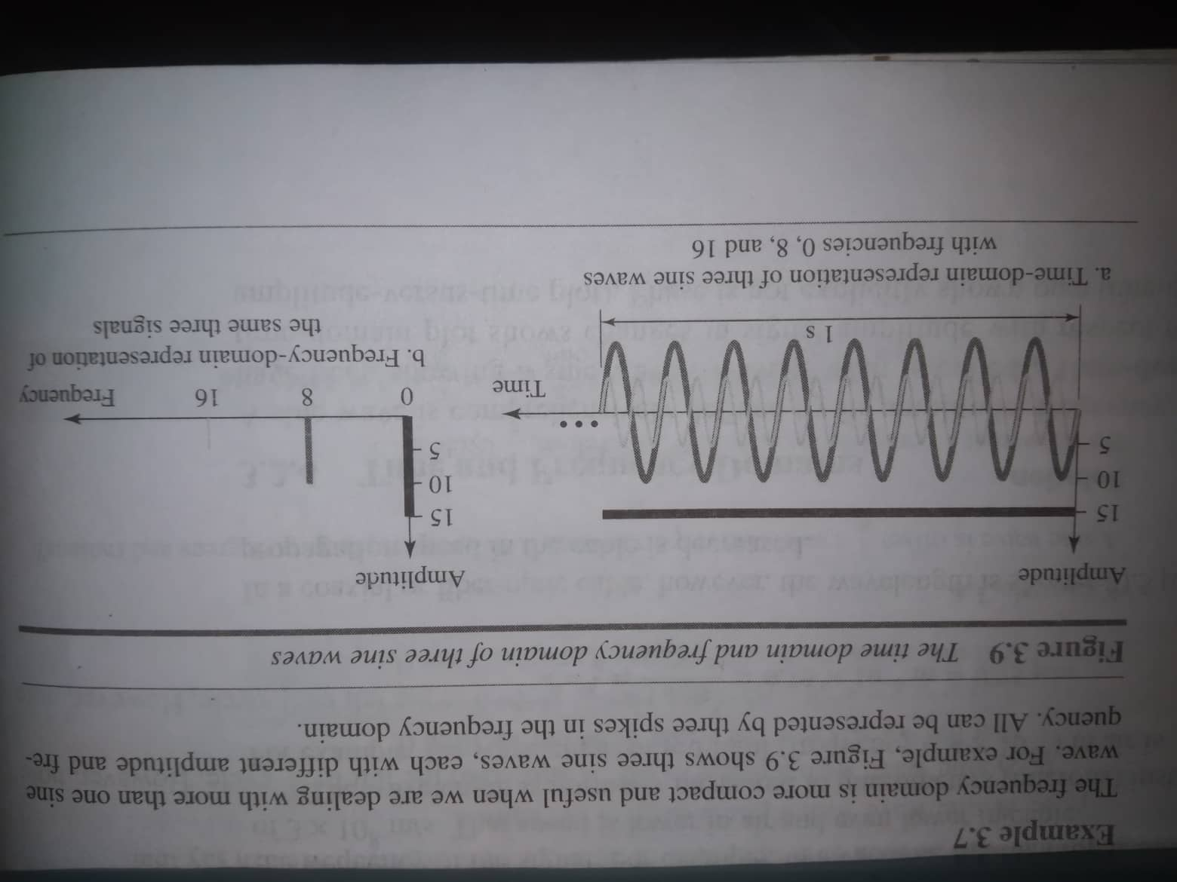
Time and Frequency Domain (composite signal)

Slide 32
Bandwidth
A single frequency sine wave is not useful in data communication. We need to send a composite signal, a signal made of many simple sine waves. The range of frequencies contained in a composite signal is its bandwidth. The bandwidth of a composite signal is the difference between the highest and the lowest frequencies contained in that signal. If a composite signal contains frequencies between 1000-5000, its bandwidth is (5000-1000)=4000.
Unit=hertz

Slide 33
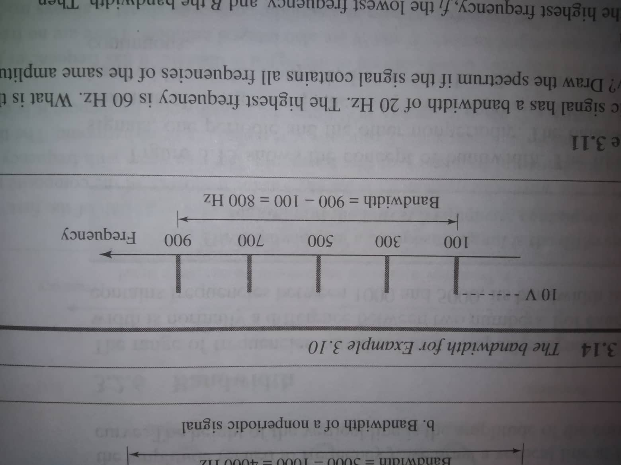
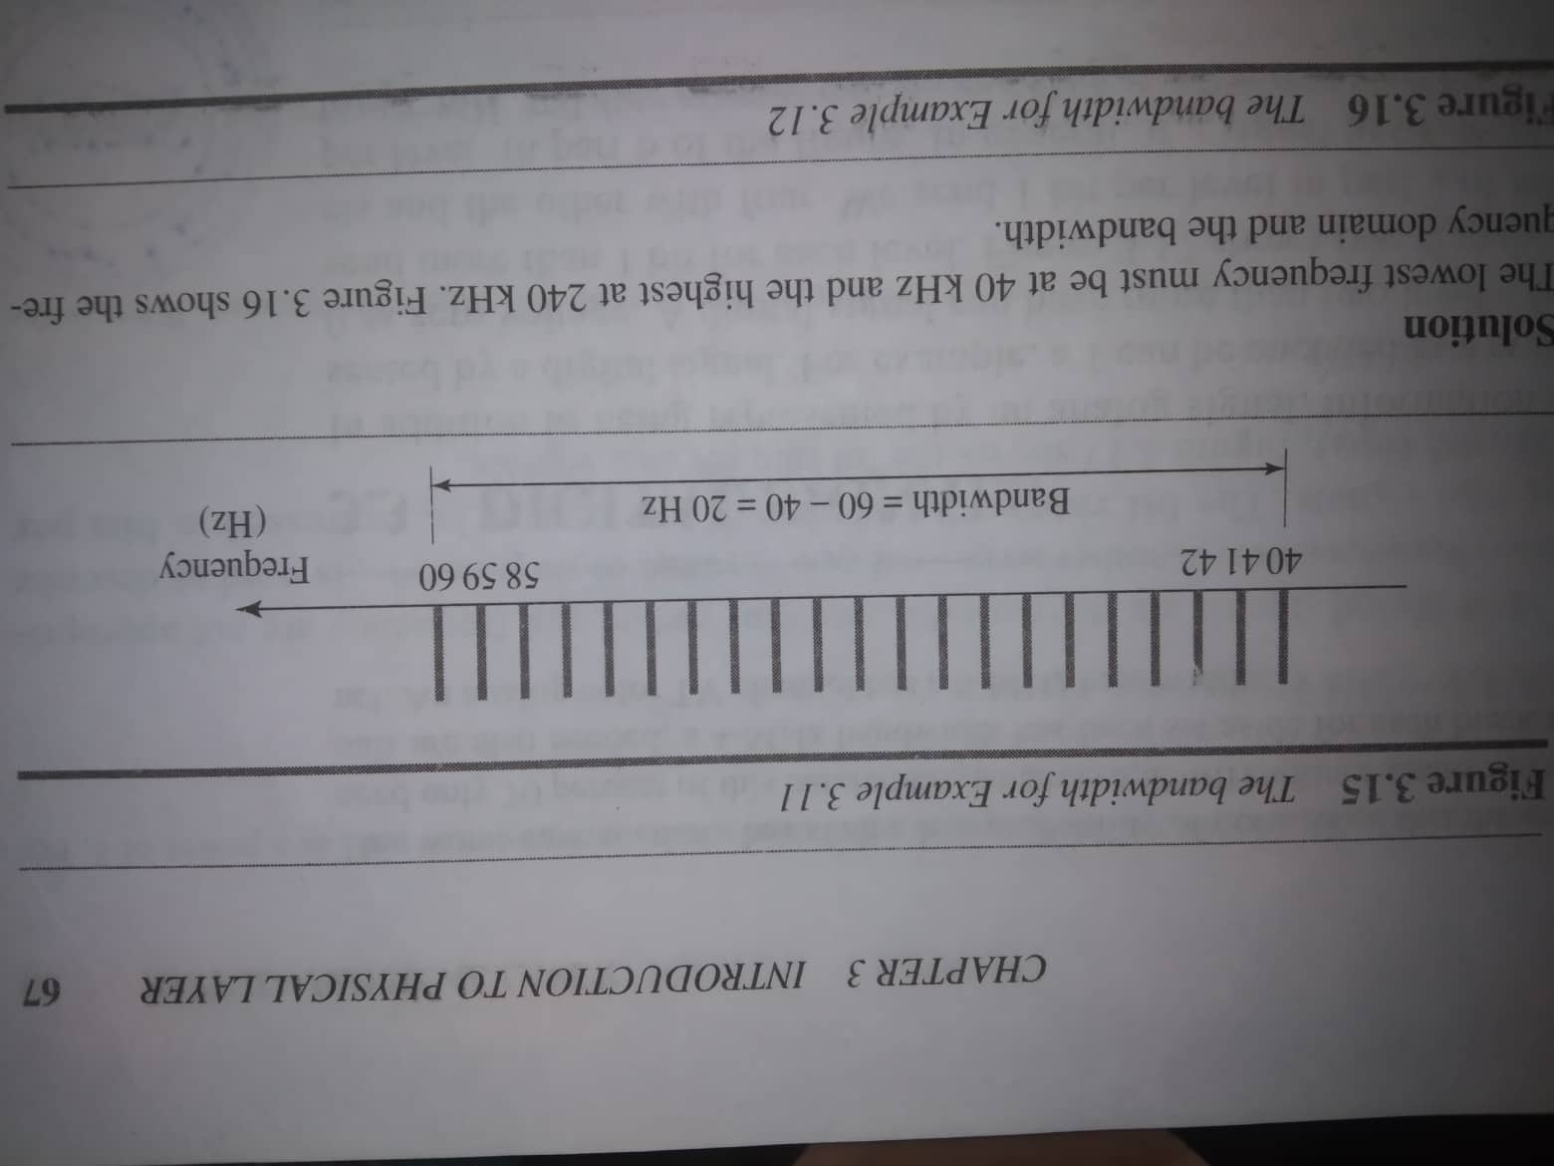
Bandwidth

